Slide 2
Stacks
Stack : a collection whose elements are added and removed from one end, called the top of the stack
Stack is a LIFO (last in, first out) data structure
Examples:
A stack of plates – what can we do with the elements of this collection?
Other real-world examples of stacks?
Notes:
Can add a plate to the top, take a plate form the top, look at the top plate Can check if the stack is empty.
We do not take a plate from the middle of the pile! (usually) So, where is all the activity for a stack of plates?

Slide 3
Conceptual View of a Stack
Adding an element
New object is added as the new top element of the stack
(old) top of stack
new top
bottom of stack
bottom

Slide 4
Conceptual View of a Stack
Removing an element
Object is removed from the top of the stack
top
new top
bottom
bottom

Slide 5
Uses of Stacks in Computing
Useful for any kind of problem involving LIFO data
Backtracking: in puzzles and games
Browsers
To keep track of pages visited in a browser tab

Slide 6
Uses of Stacks in Computing
Word Processors, editors
To check expressions or strings of text for matching parentheses / brackets e.g. if (a == b) { c = (d + e) * f; }
To implement undo operations
Keeps track of the most recent operations
Markup languages (e.g. HTML, XML): have formatting information (tags) as well as raw text
To check for matching tags e.g. <HEAD> <TITLE>Computer Science 1027a</TITLE> </HEAD>

Slide 7
Uses of Stacks in Computing
Stack Calculators
To convert an infix expression to postfix, to make evaluation easier (more on this later)
Infix expression: a * b + c
Postfix expression: a b * c +
To evaluate postfix expressions (ditto)
Compilers
To convert infix expressions to postfix, to make translation of a high-level language such as Java or C to a lower level language easier

Slide 8
Uses of Stacks in Computing
Call stack (Runtime stack)
Used by runtime system when methods are invoked, for method call / return processing (more on this later)
e.g. main calls method1 method1 calls method 2 method 2 returns …
Holds “call frame” containing local variables, parameters, etc.
Why is a stack structure used for this?

Slide 9
Operations on a Collection
Every collection has a set of operations that define how we interact with it, for example:
Add elements
Remove elements
Determine if the collection is empty
Determine the collection's size
Notes:
9

Slide 10
Stack Operations
push: add an element at the top of the stack
pop: remove the element at the top of the stack
peek: examine the element at the top of the stack
It is not legal to access any element other than the one that is at the top of the stack!

Slide 11
Operations on a Stack
Operation | Description
push | Adds an element to the top of the stack
pop | Removes an element from the top of the stack
peek | Examines the element at the top of the stack
isEmpty | Determines whether the stack is empty
size | Determines the number of elements in the stack
toString | Returns a string representation of the stack

Slide 12
Introduction to Stacks
Consider a card game with a discard pile
Discards always placed on the top of the pile
Players may retrieve a card only from the top
We seek a way to represent and manipulate this in a computer program
This is a stack
What other examples can you think of that are modeled by a stack?

Slide 13
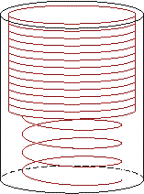
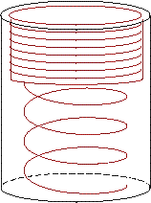
Introduction to Stacks
A stack is a last-in-first-out (LIFO) data structure
Adding an item
Referred to as pushing it onto the stack
Removing an item
Referred to as popping it from the stack

Slide 14
A Stack
Definition:
An ordered collection of data items
Can be accessed at only one end (the top)
Operations:
construct a stack (usually empty)
check if it is empty
Push: add an element to the top
Top: retrieve the top element
Pop: remove the top element

Slide 15
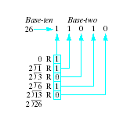
Example Program
Consider a program to do base conversion of a number (ten to two)
Note program which assumes existence of a Stack class to accomplish
Demonstrates push, pop, and top

Slide 16
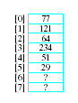
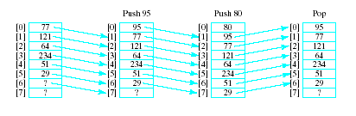
Selecting Storage Structure
Model with an array
Let position 0 be top of stack
Problem … consider pushing and popping
Requires much shifting

Slide 17
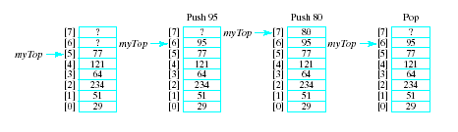
Selecting Storage Structure
A better approach is to let position 0 be the bottom of the stack
Thus our design will include
An array to hold the stack elements
An integer to indicate the top of the stack
Note beginning of Stack.h file, Fig. 7.3

Slide 18
Implementing Operations
Constructor
Compiler will handle allocation of memory
Empty
Check if value of myTop == -1
Push (if myArray not full)
Increment myTop by 1
Store value in myArray [myTop]
Top
If stack not empty, return myArray[myTop]
Pop
If array not empty, decrement myTop
Output routine added for testing

Slide 19

The Stack Class
The completed Stack.h file
All functions defined
Note use of typedef mechanism
Implementation file, Stack.cpp
Driver program to test the class
Creates stack of 4 elements
Demonstrates error checking for stack full, empty

Slide 20
Dynamic Array to Store Stack Elements
Same issues regarding static arrays for stacks as for lists
Can run out of space if stack set too small
Can waste space if stack set too large
As before, we demonstrate a dynamic array implementation to solve the problems
Note additional data members required
DStack Data Members

Slide 21
Dynamic Array to Store Stack Elements
Constructor must
Check that specified numElements > 0
Set capacity to numElements
Allocate an array pointed to by myArray with capacity = myCapacity
Set myTop to -1 if allocation goes OK
Note implementation of constructor for DStack

Slide 22

Dynamic Array to Store Stack Elements
Class Destructor needed
Avoids memory leak
Deallocates array allocated by constructor
Note destructor definition

Slide 23
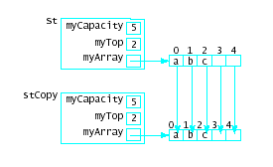
Dynamic Array to Store Stack Elements
Copy Constructor needed for
Initializations
Passing value parameter
Returning a function value
Creating a temporary storage value
Provides for deep copy
Note definition

Slide 24
Dynamic Array to Store Stack Elements
Assignment operator
Again, deep copy needed
copies member-by-member, not just address
Note implementation of algorithm in operator= definition
View driver program to test DStack class

Slide 25
Further Considerations
What if dynamic array initially allocated for stack is too small?
Terminate execution?
Replace with larger array!
Creating a larger array
Allocate larger array
Use loop to copy elements into new array
Delete old array
Point myArray variable at this new array

Slide 26
Further Considerations
Another weakness – the type must be set with typedef mechanism
This means we can only have one type of stack in a program
Would require completely different stack declarations and implementations
Solution coming
class templates

Slide 27
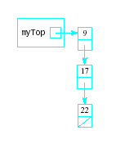
Linked Stacks
Another alternative to allowing stacks to grow as needed
Linked list stack needs only one data member
Pointer myTop
Nodes allocated (but not part of stack class)
Note declaration, Fig. 7-11

Slide 28
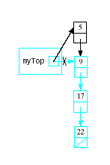
Implementing Linked Stack Operations
Constructor
Simply assign null pointer to myTop
Empty
Check for myTop == null
Push
Insertion at beginning of list
Top
Return data to which myTop points

Slide 29
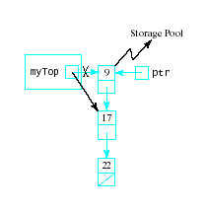
Implementing Linked Stack Operations
Pop
Delete first node in the linked list ptr = myTop; myTop = myTop->next; delete ptr;
Output
Traverse the list for (ptr = myTop; ptr != 0; ptr = ptr->next) out << ptr->data << endl;

Slide 30
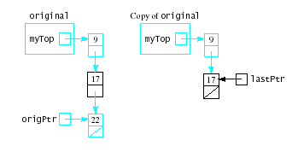
Implementing Linked Stack Operations
Destructor
Must traverse list and deallocate nodes
Note need to keep track of ptr->next before calling delete ptr;
Copy Constructor
Traverse linked list, copying each into new node
Attach new node to copy

Slide 31
Implementing Linked Stack Operations
Assignment operator
Similar to copy constructor
Must first rule out self assignment
Must destroy list in stack being assigned a new value
View completed linked list version of stack class
Note driver program

Slide 32
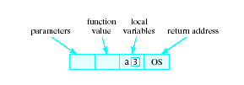
Application of Stacks
Consider events when a function begins execution
Activation record (or stack frame) is created
Stores the current environment for that function.
Contents:

Slide 33
Run-time Stack
Functions may call other functions
interrupt their own execution
Must store the activation records to be recovered
system then reset when first function resumes execution
This algorithm must have LIFO behavior
Structure used is the run-time stack

Slide 34
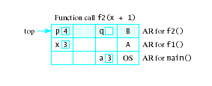
Use of Run-time Stack
When a function is called …
Copy of activation record pushed onto run-time stack
Arguments copied into parameter spaces
Control transferred to starting address of body of function

Slide 35
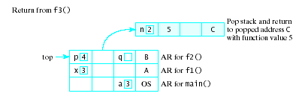
Use of Run-time Stack
When function terminates
Run-time stack popped
Removes activation record of terminated function
exposes activation record of previously executing function
Activation record used to restore environment of interrupted function
Interrupted function resumes execution

